Slide 1
Design Thinking Guide
for Schools
A structured approach to
teaching and assessing
the 21st century skills
Notes:
Welcome/ greet

Slide 2
Session 1
Notes:
Facilitator ask them what are the educators expectation of the session. Introduce them to the session objectives.

Slide 3
Objectives
To give teachers an experience of design mindset values:
Optimism
Collaboration
Empathy
Notes:
Facilitator ask them what are the educators expectation of the session. Introduce them to the session objectives.

Slide 4
Building design mindset through optimism
Notes:
Introduce the activity in groups. Facilitator announces that every pair is given a situation and they have to ask what their partner thinks about it.

Slide 5
say
to whatever your partner is saying
YES,AND
NO,BUT
Notes:
In the first case, everyone is asked to say NO to whatever their partner is saying.
For eg :Person 1: Let us go for a movie
Person 2: NO

Slide 6
You decide to take the students on a field trip
Notes:
Introduce the activity in groups. Facilitator announces that every pair is given a situation and they have to ask what their partner thinks about it.

Slide 7
SHARE
Notes:
Let the educators share their insights on the activity.
Ask questions : How they felt when their partner said NO. Ask them what is the difference between saying BUT in every situation? What does it lead to? How does saying AND help collaboration.
Close the loop by saying “how the importance of being open to new ideas and being optimistic and saying AND instead of BUT.”

Slide 8
SKY
Notes:
Ask teachers to list down all the words that come to their mind when they think / see SKY
Eg: blue, high, sun, planets, moon, clouds, vast, open…

Slide 9
EARTH
Notes:
Look at the word EARTH as a contrast for SKY and list down the words that come to your mind.
For eg. Round, sphere, green, small, below, fixed in size, pollution etc…

Slide 10
Growth Mindset
Scenario 1: A child in the school bus is getting into a lot of trouble with other children. His mother comes and complains to you. How will someone react with a growth mindset and how will someone with a fixed mindset will react?
Scenario 2: School is over and you are about to leave. A colleague calls you who has already left. She left some papers at school and does not remember where she kept them. She is asking for help. How will a person with growth mindset and fixed mindset react in this situation?
Notes:
Once they're done, lead a discussion on the 'Sky' vs 'Earth' – as metaphors for Growth Mindset vs Fixed Mindset
Facilitator puts up the scenario and lets the participants do a role play with the given scenarios.
Few guiding questions for engagement:
- which is more effective?
- how did you feel when you did Sky? Earth?
- why don't we do 'Sky' more often?
- what are the benefits of a 'Sky' approach, for YOU?

Slide 11
“Everything you see around you is designed by man, except Nature!”
David Kelly| Founder, IDEO

Slide 12
What if……
We could design HUMAN NATURE

Slide 13
Human Nature
EMPATHETIC
RESPONSIBLE
CREATIVE
OPTIMISTIC

Slide 14
I design to be ‘different’
I design to make a ‘DIFFERENCE’
DESIGN
THINKING

Slide 15
BAG Activity
Make pairs ( partner A and partner B )
Design ( illustrate ) an ideal daily bag/purse for your partner

Slide 16
BAG Activity
FACT physical/material/color/cost/ weight/brand
USE
Shapes/size/texture/senses
USE
What it does? How it helps? Where/when do you use it? How you use it?
RELATIONSHIPS
What does your partner have in their bag that you don’t what would he/she hate to lose what gets removed/added in the bag daily
How has your personalized the bag
360⁰ tool

Slide 17
BAG Activity
Using the insights gained, now
REDESIGN / ILLUSTRATE
the bag/purse that you will now gift
your partner

Slide 18
Taking Design for Change to your classroom!
Notes:
Show the DFC Pakistan video /Kiran’s video - https://youtu.be/M4u2r3jdG6Y?list=PLOS7LSVwOyfI976pDE3PxtqBQ_FYQAd5r

Slide 19
Current Scenario
a feel good
social emotional
program
one size fits all
content heavy
test oriented
‘Either’ ‘Or’ Model

Slide 20
Imagine if every person graduated with..
PASSION
CONTENT
DOING WELL
COMPASSION
CHARACTER
DOING GOOD
‘Both’ ‘And’ Model

Slide 21
Power of Design Thinking
nurtures
SOCIAL-EMOTIONAL
COMPETENCIES
develops
21ST CENTURY
SKILLS

Slide 22
Taking the I CAN SUPERPOWER to the World

Slide 23
How we Do it
FEEL
IMAGINE
DO
SHARE
what bothers me the most,
transform helplessness into
empowerment
brainstorm ways to take the
current situation to a preferred
state for self and others
do what it takes to bring
about change with
courage and determination
share my story to
inspire others
to be the change
FIDS = I CAN Superpower

Slide 24
Session 2

Slide 25
Why is it important
When you want to create a better solution, you need to empty your mind of all the assumptions and start afresh. This stage helps you observe and identify opportunities for change and engage with the user.
What does it develop
What does it cultivate
FEEL
21ST CENTURY SKILLS
EMPATHY
Self Awareness
Observation
Effective Communication
what bothers me the most,
transform helplessness into
empowerment
Notes:
Before we begin, Ask “ Why do you think feel is important?” Take a few response, then introduce them to why is it important. The 21st century skills that gets fostered during the process and the value that it helps inculcate.

Slide 27
Being a Cartographer
Choose an opportunity of change (Individual activity)
Step 1
Map your world
SEE- Use your power of Observation
HEAR- Use your power of Listening
FEEL- Use your power of Attention
FEEL
Notes:
Video

Slide 28
Add
Hot Spots (things that bother you) ☹
Bright Spots (things that are good but can be improved/sustained) ☺
FEEL
Notes:
Educators choose a challenge.

Slide 29
Step 2:
Choose one
Opportunity of Change
from your map
(remember it could be a hot spot
or a bright spot)

Slide 30
Step 3
Present your opportunity of change
to the group, and as a group vote on
ONE
Being a detective:
Who are the people involved in this opportunity of change ?
What do you know about their behaviour?
What kind of environment exist at these places ?
FEEL
Notes:
Facilitator says “ Once we have taken up the challenge, we’ll go deeper into it and understand its impact on three levels- First people, Their behaviour and the environment.” Keeping the three questions in mind, operating from the growth mindset, the challenge turns into Opportunity of Change. Here we have to play a role of Detective to uncover the people, behaviour and environment.

Slide 31
Being a detective:
Who are the people involved in this opportunity of change ?
What do you know about their behaviour?
What kind of environment exist at these places ?
Choose a challenge
Staffroom doesn’t have space
Stinking bathrooms
Lunch time is chaotic
FEEL
Notes:
Choose a challenge

Slide 32
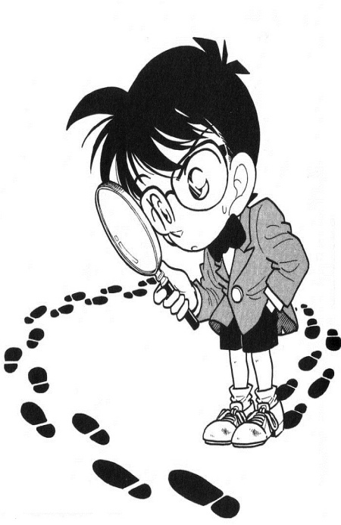
Notes:
Video - Weebly

Slide 33
Being a Detective
Who are the people involved in this opportunity of change ?
What do you know about their behaviour?
What kind of environment exist at these places ?
FEEL
Notes:
Facilitator says “ Once we have taken up the challenge, we ll go deeper into it and understand its impact on three levels- First people, Their behaviour and the environment.” Keeping the three questions in mind, operating from the growth mindset, the challenge turns into Opportunity of Change. Here we have to play a role of Detective to uncover the people, behaviour and environment.

Slide 34
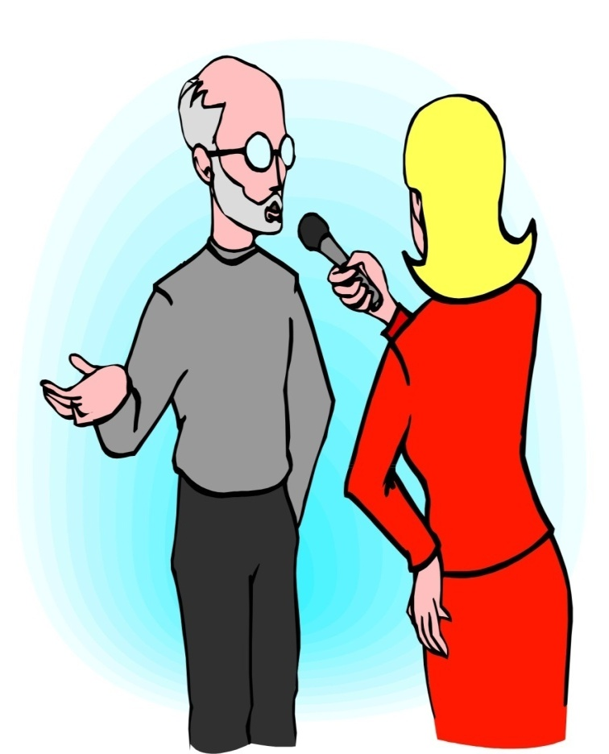
Notes:
Video – weebly link

Slide 35
Preparing for interview
Identify one or two stakeholder who you would like to interview
Draft questions in advance
Include more exploratory questions
Do a mock interview with a peer
FEEL
Notes:
Now that we have identified our people involved ,their behaviour and the environment. It is time to be a reporter and dig deeper to understand the situation better, hence talking to people becomes a very crucial step. Keeping the factual questions in mind, Here we‘ll be focusing more on the exploratory questions.

Slide 36
Being a Reporter
Take an Interview keeping the following points in mind:
Talk to people involved in the situation to look at the opportunity from their perspective.
Interview a real person who is actually involved in the situation.
Learn to take the user’s perspective.
FEEL
Notes:
Now that we have identified our people involved ,their behaviour and the environment. It is time to be a reporter and dig deeper to understand the situation better, hence talking to people becomes a very crucial step. Keeping the factual questions in mind, Here we ‘ll be focusing more on the exploratory questions.

Slide 37
Few things to keep in mind during the interview process
Aim for short questions and long answers
Avoid yes or no questions
Avoid interrupting people or suggesting what they should say
If we are talking all the time or thinking about our next question, you’ll miss most important moment
FEEL

Slide 38
Step 3:
What the root cause of the problem is?
What is it that they would like to address to change the situation?
FEEL
Notes:
Each group shares the root cause and how would like to address it.
“Wrapping up”
Facilitator closes the loop by saying “It is important to take a pause before we start thinking of solutions because we often end up solving the wrong problem. Talking to people involved in the situation and observing allows to understand the root cause of the problem. And then we jump to solutions. “

Slide 39
BREAK
Notes:
Each group shares the root cause and how would like to address it.
“Wrapping up”
Facilitator closes the loop by saying “It is important to take a pause before we start thinking of solutions because we often end up solving the wrong problem. Talking to people involved in the situation and observing allows to understand the root cause of the problem. And then we jump to solutions. “

